Slide 1






AI-Generated Python Code Detector
Group 28
Li Yiran 121090291
Li Bingrong 121090256
Wang Xun 121090570
Liang Ruoyu 121090311
Elizaveta Slavinskaia 124400015

Slide 2
BACKGROUND
AI-driven code generation tools have revolutionized software development, but distinguishing between human-written and AI-generated code remains a major challenge.
Why it matters?
Code quality and security
Protecting intellectual property and preventing plagiarism
Ensuring ethical use of AI in development.
Challenge:
AI-generated code tends to be predictable and smooth, while human-written code contains more random deviations.
Traditional detection methods are insufficient in addressing these issues.

Slide 3

NOVELTY
Previous work:
Most methods use either transformers (e.g., CodeBERT) or Graph Neural Networks (GNNs) to detect AI-generated code.
Our approach:
Combining CodeBERT with GNNs on Abstract Syntax Trees (ASTs) using Cross-Modal Attention, and integrate statistical features (e.g., entropy) for better performance.
This multi-modal architecture captures both the meaning and structure of code, improving detection accuracy.
A more robust and effective system for detecting AI-generated code!
(improvement over traditional GNN and CodeBERT-based classifiers)

Slide 4
DATA PREPROCESSING
Data Source:
Python codes written by humans
CodeSearchNet Python Subset
https://huggingface.co/datasets/code_search_net
label=0
Python codes generated by AI
MBPP - Mostly Basic Python Problems (with GPT code)
https://huggingface.co/datasets/mbpp
label=1

Slide 5
DATA PREPROCESSING
Normalization & Feature Extraction
Code Normalization
Whitespace/indentation standardization (tabs→spaces, trim lines)
Comment removal (regex for #, ''', """)
AST-robust parsing (min-indent preservation, try-except fallback)
Feature Engineering
Basic stats: Code length, avg line length, parenthesis ratio
AST features: Node count, IF depth, function calls
Lexical: Keyword density (e.g., if, def)

Slide 6
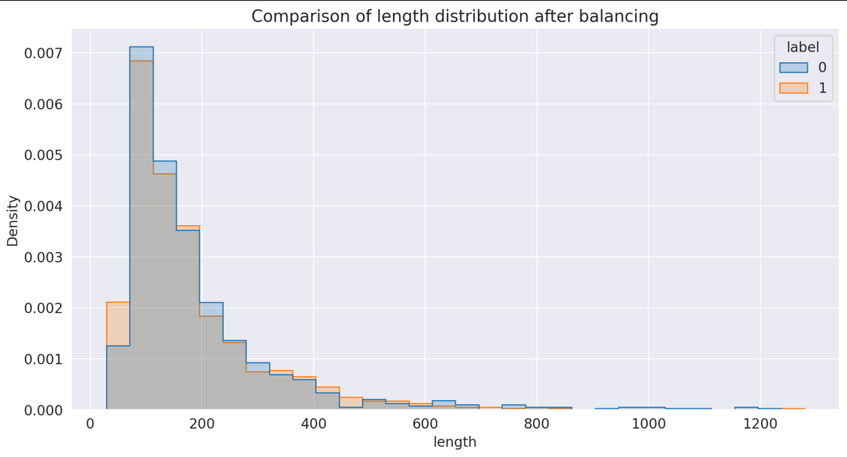
DATA PREPROCESSING
Balanced Representation & Quality Control
Stratified Balancing
Binned AI/human samples by code length
Matched sample counts per bin (avoided length bias)
Validation
Filtered anomalies: Zero-length, extreme parenthesis ratios

Slide 7
METHODOLOGY
Hybrid Architecture
CodeBERT
Pre-trained on 6.2M code samples
Captures contextual anomalies in code tokens
Detects "over-smooth" patterns (AI) vs. human randomness
GNN on AST
Processes code as graph (nodes=AST elements)
Identifies:
Mechanical code repetition
Over-precise branching structures
Abnormal node connections
Statistics
Lexical entropy (lower in AI code)
Comment pattern analysis:
AI: Formulaic/no comments (75% cases)
Human: Irregular but meaningful

Slide 8
METHODOLOGY
Why It Works:
CodeBERT ➔ Semantic anomalies
GNN ➔ Structural rigidity detection
Stats ➔ Surface-level forensic signals
Complementary error patterns → 20%↑ Fusion vs single models

Slide 9
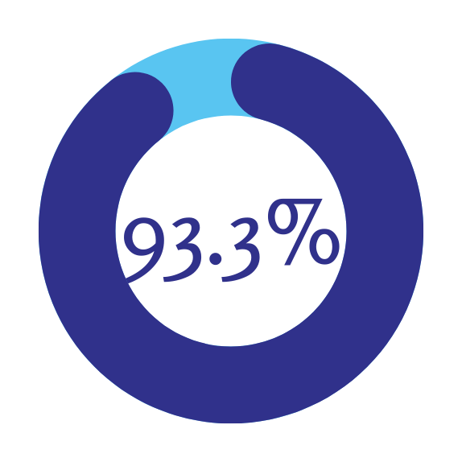
RESULT
5-Fold Average Results | 5-Fold Average Results | 5-Fold Average Results | 5-Fold Average Results | 5-Fold Average Results | 5-Fold Average Results
Metric | Accuracy | Precision | Recall | F1 Score | AUC
Value | 93.31% | 91.35% | 96.26% | 93.68% | 93.22%

Slide 10
ANALYSIS
Complementary Error Patterns:
CodeBERT may miss some structural details
GNN may miss semantic nuances
Fusion compensates for both, improving robustness and efficiency

Slide 11
CONCLUSION
In this study, we successfully developed a model that leverages the strengths of both CodeBERT and GNN to effectively detect AI-generated code. By combining the semantic anomaly detection capabilities of CodeBERT with the structural rigidity analysis provided by GNN, our model achieves superior performance compared to traditional methods.

Slide 12
THANK
YOU

Slide 13
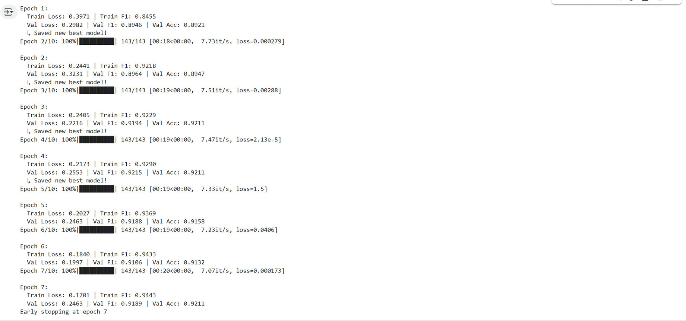
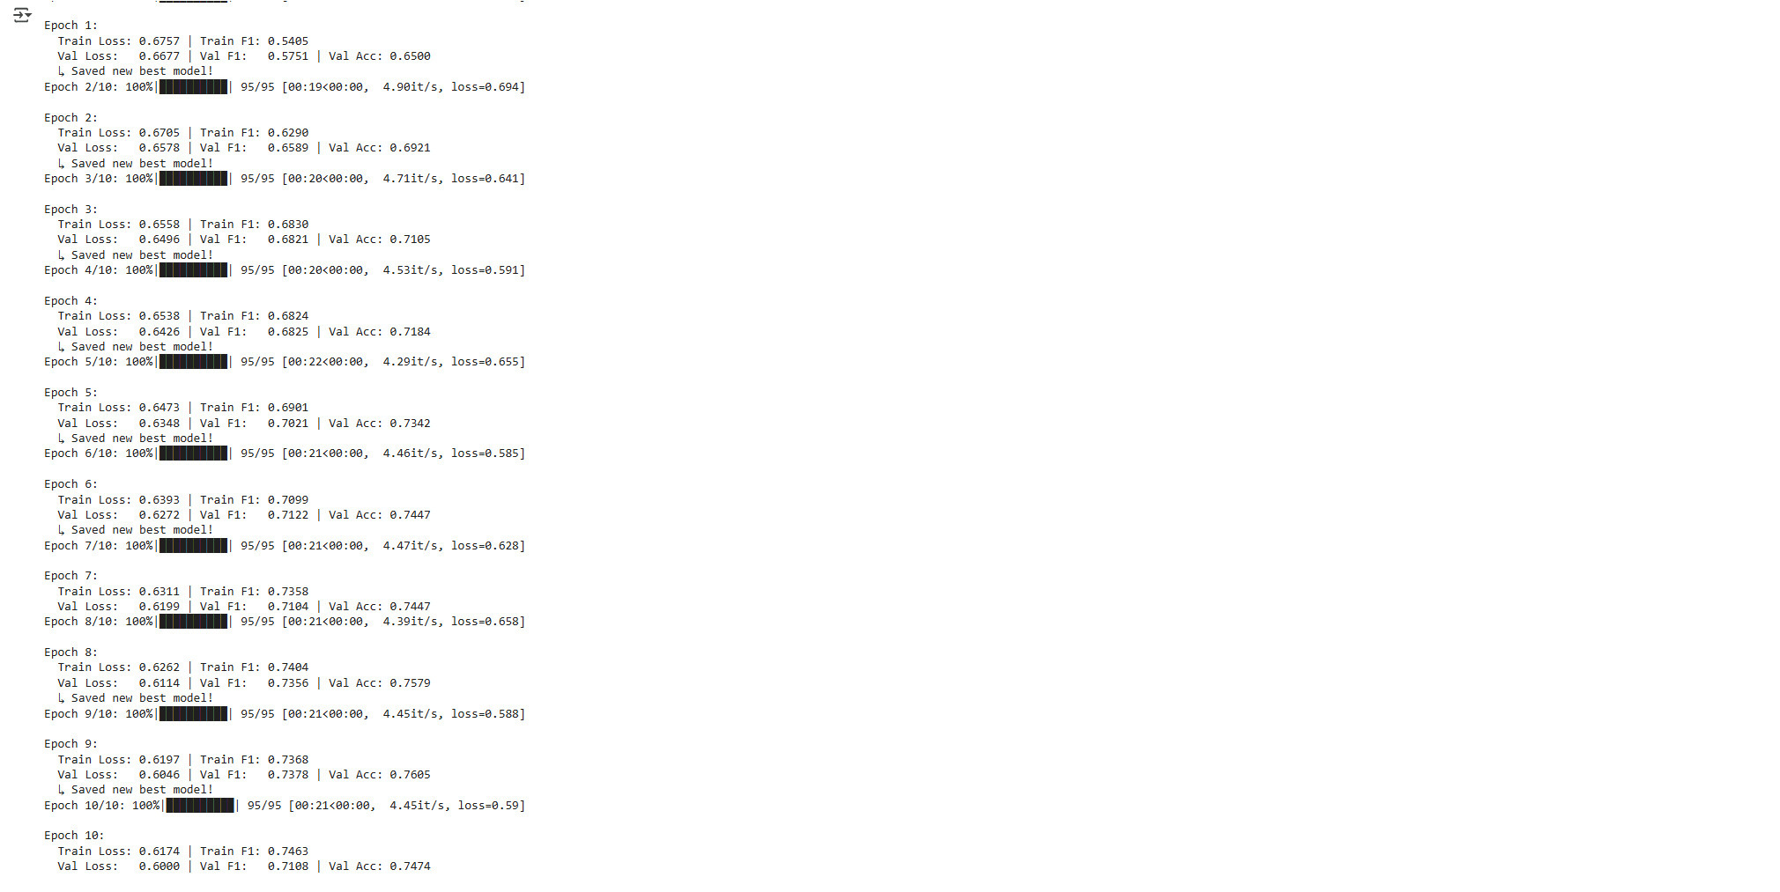
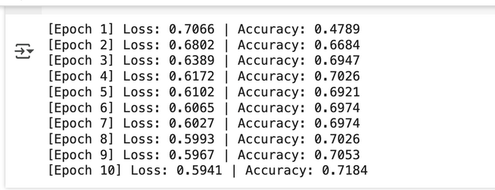
APPENDIX

